Slide 1

Team Name : Techie Girls
Team Details : Prachi Bahadur Singh
Ambati Kedar Priya
Srishti Anand

Slide 2
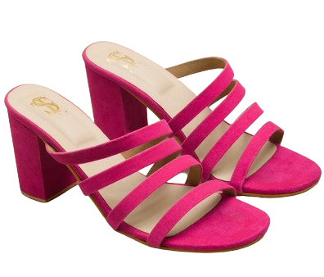

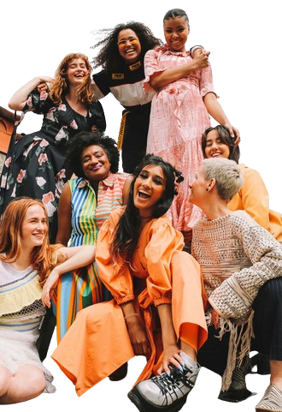
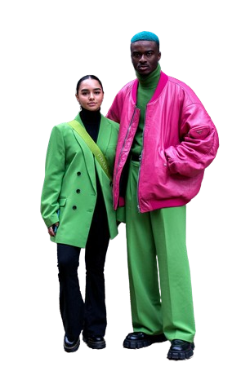

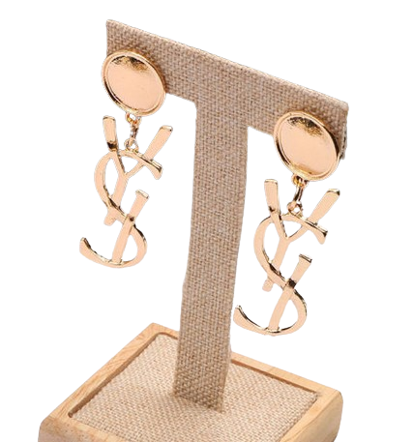

WELCOME TO THE FUTURE OF
MYNTRA MUSE
WHY?
In the fast-paced world of fashion, staying ahead of the curve is essential. Our innovative approach leverages real-time data to accurately forecast trends, ensuring that Myntra remains at the forefront of the industry. Join us as we explore how precise predictions can revolutionize production and procurement, tailored for the ever-evolving demands of the Gen Z consumer.
UNDERSTANDING THE PROBLEM STATEMENT
Trend Demand Forecasting
Utilizing real-time data to forecast fast fashion trend demand on our platform.
Ensuring accurate predictions for shorter timeframes for productions and procurement adjustments.
"Understanding what our customers want before they even know it themselves is key to staying competitive in the fast fashion industry"
With real-time trend forecasting, we can anticipate consumer desires and provide personalized shopping experiences. This not only increases customer satisfaction but also fosters loyalty. Happy customers are more likely to return and make repeat purchases, driving up sales and enhancing our brand reputation. Our approach ensures that we always have the right products at the right time, creating a seamless and delightful shopping experience

Slide 3

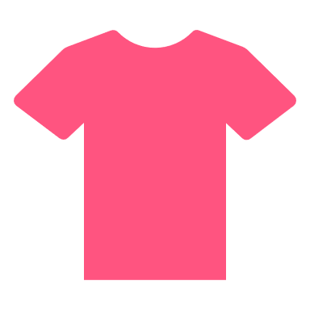





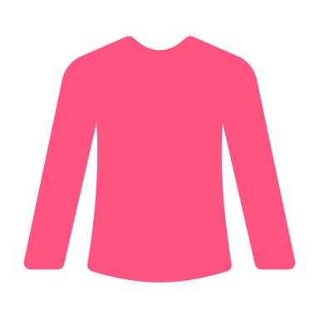
Trendsetting Movie Fashion: Outfit Class Recognition
Blouse
Culottes
Tee
We will develop a sophisticated model designed to identify and classify the types of outfits featured in movie posters. By leveraging this model, we can gain insights into the fashion trends depicted in popular films, providing a deeper understanding of the styles and attire that capture the audience's attention.
Jodhpurs
Anorak
Dress
Jacket
Henley
Poncho
1
2
3
Robe
The model is trained on a DeepFashion Dataset ,a large-scale clothes database for Clothing Category and Attribute . The DeepFashion Database contains several datasets .For this project ,the Category and Attribute Prediction Benchmark was used . This dataset contains 289,222 diverse clothes images from 46 different categories .The dataset contains the location of the images and the labels as a string object , one label per image.
Then we employ the FastAI library's data augmentation strategy known as "presizing" to enhance our model's performance. Presizing is a technique used to improve the training of deep learning models, particularly in the context of image classification tasks. Presizing involves resizing images to a slightly larger size than the final desired input size before applying any data augmentation. After resizing, data augmentations such as random cropping, rotation, flipping, and more are applied, followed by cropping or resizing to the final input size that the model expects. This strategy ensures that the model sees a variety of augmented views of the original image, promoting better generalization and robustness.
In this project we want to recognize different types of clothes. Apparently, our classification categories differ from the original classes in the ImageNet dataset which was used to train ResNet34 model. In order to make transfer learning work, we need to replace the last layer of the network with a new linear layer containing the same number of activations as the number of classes in our dataset. In our case we have 46 clothes categories, meaning that we have 46 activations in our new layer. The newly added layer does not contain pre-trained weights and initializes them at random. Therefore, our model will have random output before it is trained, which doesn't mean that the model is entirely random. All the other layers that were not changed will preserve the same weights as the original model and will be good in recognizing general visual concepts such as basic geometric figures, gradients, etc. Therefore, when we are tuning our model to be able to recognize clothes types, we freeze the entire network, but the last layer. That will allow us to optimize the weights of the last layer without changing the weights of the deeper layers.
Sweatpants
Skirt
Kimono
Sweatshorts
Jerseys
Tee
Tank
Coat
Caftan
Blazer
Hoodie
Romper
Top
Leggings
Oneside
Jeggings
Gauchos
Trunks
Sarong
4
Jumpsuits
Kaftan
Chinos
We then move to create confusion matrix .Examining the Confusion Matrix allows us to evaluate the performance of our neural network by showing how often different classes are misclassified. For instance, the network might confuse 'Top' with 'Blouse' or 'Romper' with 'Dress', highlighting areas where the model struggles. These insights help us understand the model's limitations.
Flannel
Cardigan
5
Halter
Button-down
Joggers
Turtleneck
As was mentioned previously the layers transferred from the pre-trained model are already good at recognizing fundamental visual concepts and do not require much training. While deeper layers that are responsible for recognizing complex shapes specific to our project, still will benefit from higher learning rates. Therefore ,we use smaller learning rates(1e-7) for the first layers and bigger learning rates(1e-3) for the last layers, to allow them to fine-tune more quickly than earlier layers. Finally ,after training for 6 epochs ,we evaluate our model on test set and calculate accuracy.Top-1 Accuracy of the model on the user-specified data is 62% which is lower than on DeepFashion Dataset. However, it is still good for a 46-class classification model.
Coverup
Shorts
Peacoat
Jeans
Cutoffs
Parka
Sweater
Bomber
Coverup

Slide 4
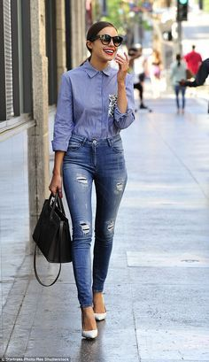
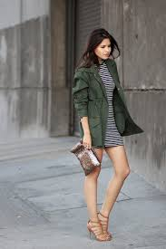

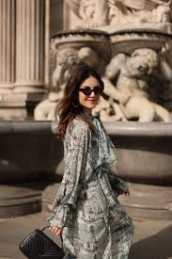





Trendsetting Movie Fashion: Outfit Type Recognition
Our next goal is to develop a model capable of recognizing and categorizing the patterns on outfits, such as striped, floral, print, and more. This enhancement aims to deepen our understanding of object properties, enabling more precise and nuanced fashion analysis.
Denim
Print
Striped
This model is also trained on the DeepFashion dataset. In this model, the dataset includes image links alongside their training labels. The training labels are represented as one-hot encoded vectors, encompassing categories like striped, printed, and floral etc.
We will be using FBeta as the evaluation metric for this model because of one-hot encoded nature of training labels .FBeta is a generalization of F-score. While F-score is defined as the harmonic mean of precision and recall and gives each the same weight, FBeta adds a configuration parameter called beta. The beta parameter determines the weight of recall in the combined score. beta < 1 lends more weight to precision, while beta > 1 favors recall.
In fast AI the default choice of the loss function for a multi-label classification problem is a BCEWithLogitsLossFlat, which is a Binary Cross Entropy with Logits (in fact a sigmoid function, which is an inverse of the logit function and maps arbitrary real values of Cross-Entropy back to the [0, 1] range which is what we usually want for the targets encoded between 0 and 1).We will create a custom loss class, LabelSmoothingBCEWithLogitsLossFlat, which wraps the existing BCEWithLogitsLossFlat function. This custom class will apply label smoothing, a technique that adjusts the target labels to be less confident, before computing the binary cross-entropy loss with logits. Label smoothing helps in regularizing the model, reducing overfitting, and improving generalization by preventing the model from becoming overly confident in its predictions.
After defining all the necessary parameters, we will use a Resnet34 architecture pretrained on the ImageNet dataset. When we call learn.fine_tune(), we freeze the entire network, and train for an epoch only the randomly initialized activations of the newly created layer. Then we unfreeze the network and train all layers together for the number of epochs we specified (in our case two).
After fine tuning, we aim to find the optimum learning rate that will allow network to converge faster . We go through the data in our DataLoader and gradually increase the learning rate with each mini-batch, to observe how the value of loss changes with the change of learning rate.
Hurray!!! Our model shows an F1 score of 0.984 on test set.
We have successfully identified the optimal learning rates and decided to use a learning rate of 5e-7 for the initial layers and 1e-4 for the final layer. We will finally train the model with these settings for 8 epochs.

Slide 5


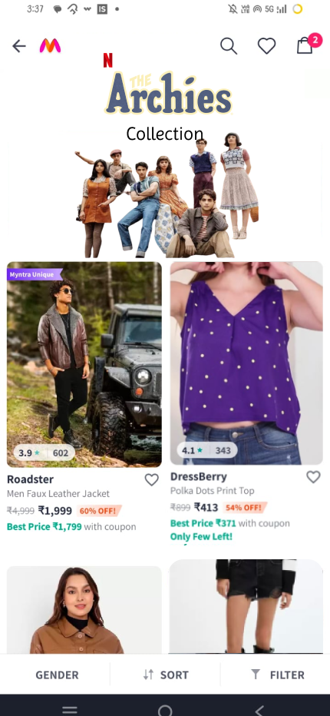
Overall Workflow
START
Further we also analyzed these posters using our trained type(striped , floral) recognition model to predict the outfit type present in each poster.
We analyzed these posters using our trained class recognition model to predict the outfit class (skirt, tee, shirt) present in each poster.
We began by retrieving data on trending movies and web series from TMDB API . The posters , trailers and teasers of the top three movies will be saved into our database.
The predicted labels are then sent to the Myntra MUSE app using a Flask API. This API facilitates communication between our model and the app, ensuring seamless data transfer.
Discover and shop outfits inspired by your favorite actor's style with Myntra MUSE, where curated collections based on celebrity looks are just a tap away.
Myntra MUSE uses these labels to match the predicted tags with the actual tags on clothing items available in its catalog. By doing so, it ensures that the recommendations are accurate and relevant to the users' preferences. Finally, the app presents these matched results to the users, allowing them to explore and purchase the suggested outfits even before the actual release of movie.
Notes:
Hello everyone, in this video, I'll explain the workflow of our Fashion Trend Predictor. We start by gathering data on trending movies and web series from the TMDB API. The TMDB API detects popular upcoming movies by analyzing pre-release activities such as the number of times users add movies to their watchlists, the frequency of searches for these movies, and overall user engagement. It also considers metrics from social media activity, like mentions, likes, and shares, as well as trailer views and interactions on TMDB's platform. These factors collectively help TMDB rank and identify trending movies that are yet to be released.The posters, trailers, and teasers of the top three movies are saved into our database. Our main objective is to analyze the posters of these trending movies to predict upcoming fashion trends.
To achieve this, we use a pre-trained ResNet34 model and train it on the DeepFashion dataset for outfit class recognition. This model identifies the general class of outfits. For example, if an actress in a poster is wearing a dress, the model can accurately predict that it is a dress.

Slide 6
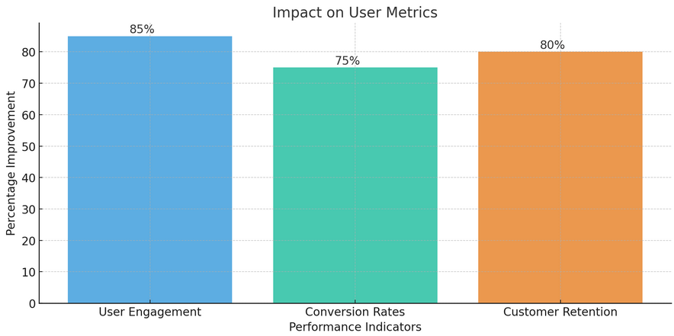
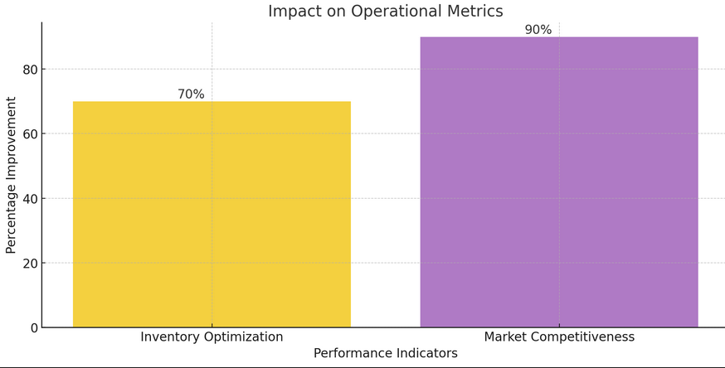
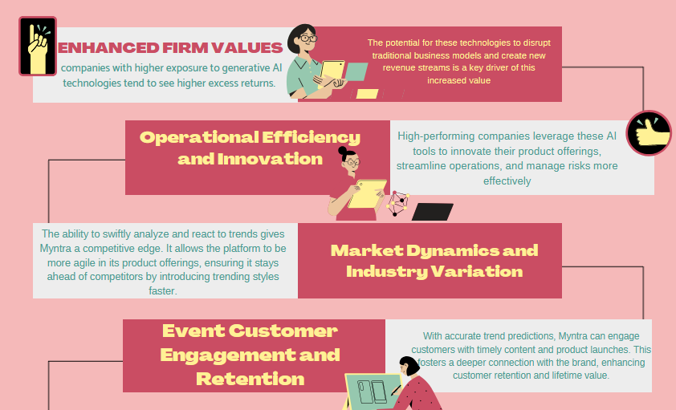
Benefits : MYNTRA MUSE
Introducing "Myntra Muse" is a game-changer for customer retention and company finances. It offers highly personalized product recommendations, boosting engagement and conversion rates. The precise trend alignment enhances the shopping experience, while AI-driven insights optimize inventory management, reducing markdowns and improving profitability. This innovative approach not only meets current cultural demands but also fosters brand loyalty, driving significant financial growth.
This graph highlights how personalized recommendations based on trending movies and series can significantly enhance user interaction, increase purchase likelihood, and improve customer loyalty.
Notes:
Hello everyone, in this video, I'll explain the workflow of our Fashion Trend Predictor. We start by gathering data on trending movies and web series from the TMDB API. The TMDB API detects popular upcoming movies by analyzing pre-release activities such as the number of times users add movies to their watchlists, the frequency of searches for these movies, and overall user engagement. It also considers metrics from social media activity, like mentions, likes, and shares, as well as trailer views and interactions on TMDB's platform. These factors collectively help TMDB rank and identify trending movies that are yet to be released.The posters, trailers, and teasers of the top three movies are saved into our database. Our main objective is to analyze the posters of these trending movies to predict upcoming fashion trends.
To achieve this, we use a pre-trained ResNet34 model and train it on the DeepFashion dataset for outfit class recognition. This model identifies the general class of outfits. For example, if an actress in a poster is wearing a dress, the model can accurately predict that it is a dress.

